Slide 1

Dr. Sajid Iqbal
Department of Computer Science
Bahauddin Zakariya University, Multan

Slide 2

INTRODUCTION TO Machine Learning 3rd Edition
ETHEM ALPAYDIN
© The MIT Press, 2014
alpaydin@boun.edu.tr
http://www.cmpe.boun.edu.tr/~ethem/i2ml3e

Slide 3
Dimensionality Reduction
Chapter Six

Slide 4
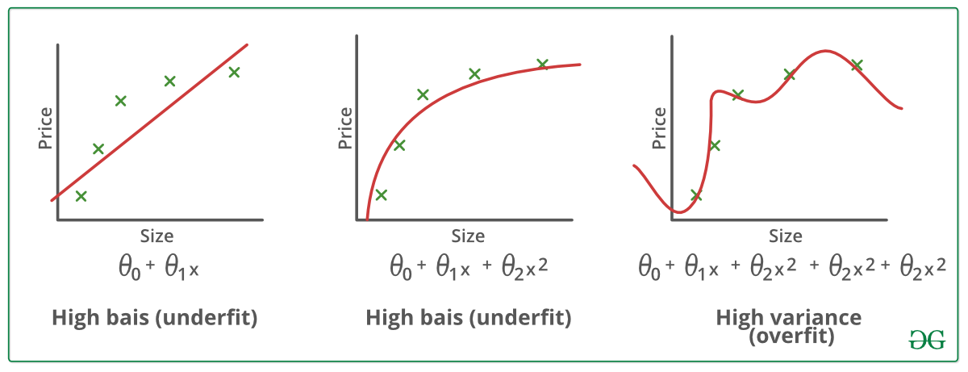

Background
The complexity of classifier or regressor depends upon the number of features
More the features, higher the model complexity
The complexity increase in terms of both time and space
The training set size requirement also increases with the increase in model complexity
The number of features is the dimensionality of data.
The ML method should automatically filter out irrelevant features
so why we are concerned about reducing the number of features?
Model complexity depends upon
Number of data dimensions $d$
Number of data instances $N$

Slide 5
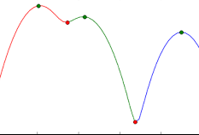
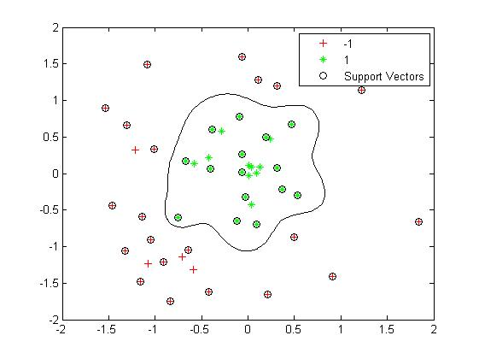
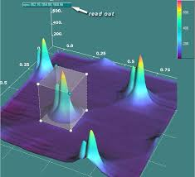
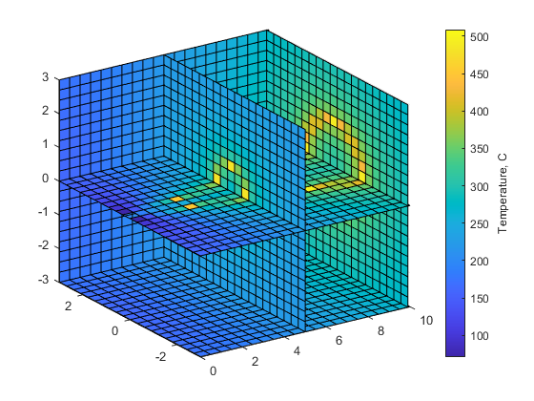
Why dimensionality reduction
Reducing memory and computation complexity
Discard the unnecessary inputs to save its extraction time
Simple models are easy to interpret
Simple models have less variance i.e. less effect of outlies
Easy visualization and understanding
?

Slide 6

Feature Reduction Methods
Feature Selection (FS)
Find $k$ high value features out of $d$ and discard the rest
Feature Extraction (FE)
Find new k-dim features using d-features
FE methods can be either supervised or unsupervised.
Linear methods
Supervised example: linear discriminant analysis
Unsupervised example: principal component analysis, factor analysis, multidimensional scaling
Nonlinear methods
Examples of nonlinear dimensionality reduction: isometric feature mapping, locally linear embedding, and Laplacian eigenmaps

Slide 7

Subset Selection
Find the best subset of the set of d-features
A subset that contains least number of dimensions contributing most to model accuracy
For a set of $d$-features, there are $2^{d}$ possible subsets
Use heuristics to find reasonable (not optimal) solution in reasonable (polynomial) time
An error function is used to measure the effectiveness of a feature (variable)
Usually the error function is mean square error (MSE) or misclassification error (MCE)
For this purpose, the data is divided into two sets normally
Training set: used to train the subset-selection model
Validation set: used to test the performance of subset-selection model

Slide 8

Subset selection
Two ways of subset selection
Forward selection
Let d-features are in given data
Select the feature which reduces the error most and add it to subset
Remove the feature from $d$-feature-set to obtain $(d−1)−$features
Find next high value feature from $(d−1)−$feature set and remove it
Find next high value feature from $(d−2)−$feature set and remove
Repeat process for $k$-times
Backward selection
Suppose all features are high value features and add them to d-subset
Find and remove the lowest value feature to get $(d−1)−$subset
Find and remove the next lowest value feature to get $(d−2)−$subset
Repeat until $k$-features are left

Slide 9

Sequential Forward Selection
Let $F_{d}$ is feature set of input dimensions $i=1,2,3,4,…,d$
Let $E(F)$ error obtained using validation dataset
Start with no features $F=∅$
Train the model $M$ on training set to find $E\left(F∪x_{i}\right) ∀ x_{i}$ features
Choose $x_{i}$ that produces least value for $E$ i.e. $j=argmin_{i}[E\left(F∪x_{i}\right)]$
Add $x_{j}$ to $F$ if $E(F∪x_{j}) < E(F)$
Stop if adding any feature does not decrease $E$
A user may define another criteria of stopping
The method is also known as wrapper approach

Slide 10

Wrapper method example
We use Iris dataset for this example
Distance calculation is done using norm
$−{\left\|x−m_{i}\right\|}^{2}=−\sqrt{\left(x−m_{i}\right)+\left(x−m_{i}\right)+\left(x−m_{i}\right)+(x−m_{i})}$
Where $m_{i}$ is mean of $i^{th}$ class $m=\{m_{1},m_{2},m_{3}\}$
If x is uni-dimensional then we can find 3 values for it as follows
$d_{1}=−\sqrt{\left(x−m_{1}\right)+\left(x−m_{1}\right)+\left(x−m_{1}\right)+(x−m_{1})}$
$d_{2}=−\sqrt{\left(x−m_{2}\right)+\left(x−m_{2}\right)+\left(x−m_{2}\right)+(x−m_{2})}$
$d_{3}=−\sqrt{\left(x−m_{3}\right)+\left(x−m_{3}\right)+\left(x−m_{3}\right)+(x−m_{3})}$
The instance x will be assigned to class which has minimum distance.
Using one feature at a time for classification using Nearest Neighbor method validation accuracies are
0.76, 0.57, 0.92, 0.94, (by book) and by our experiment 61,60,96,93
So we select 4th attribute in our feature-set (by following the book)
$FS=\{F_{4}\}$

Slide 11
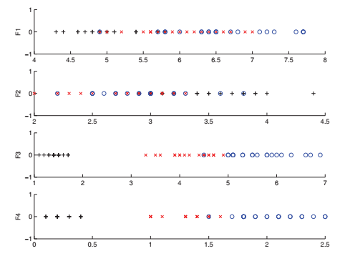
Plot of the training data for single features on Iris dataset; the three classes are shown with different symbols. It can be seen that F4 by itself allows quite good discrimination

Slide 12

Wrapper Method Example
Find two feature results $(F_{1},F_{4}),(F_{2},F_{4}),(F_{3},F_{4})$
The scores are 0.87, 0.92, and 0.96 respectively.
F3 added more value, it is included in our feature set $FS=\{F_{3}, F_{4}\}$
Next check for triplets $\left(F_{1},F_{3},F_{4}\right), (F_{2},F_{3},F_{4})$
The validation accuracies remain same, so we stop
We will discard F1 and F2 and will keep high value features i.e. F3 and F4
The feature selection is based on following two factors
The feature selection depends heavily on the classifier that we use
For small datasets, the feature selection also depends upon the way train-test split is generated
A better idea is to do multiple, random training/validation splits and decide by looking at average validation performance

Slide 13
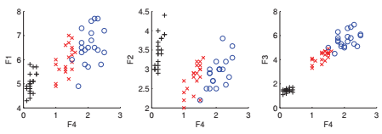
Plot of the training data with F4 as one feature, together with one of F1, F2, and F3. Using (F3, F4) leads to best separation

Slide 14

Issue with subset selection
A greedy search algorithm
For d-feature reduction to k, we need to train and predict
$d+\left(d−1\right)+\left(d−2\right)+…+(d−k)$
A compute intensive method
This is a local search procedure and does not guarantee finding the optimal subset

Slide 15

Sequential Backward Selection
Start with F containing all features
Find accuracy of model on whole feature-set
Find accuracy of model on each feature
Remove the one with least contribution $j=argmin_{i} E(F−x_{i})$
remove $x_{j}$ from $F$ if $E(F−x_{j})<E(F)$i.e. if removal of attribute decreases the error
Continue this till no more removal remain possible i.e. removal of attribute does not improve the performance
SBS is same as that of SFS however has comparatively more complexity as training on all parameters is required

Slide 16



Thanks for watching
Dr. Sajid Iqbal
Assistant Professor
Department of Computer Science
Bahauddin Zakariya University, Multan
sajidiqbal.pk@gmail.com
https://github.com/sajjo79/Design_and_Analysis_of_Algorithms
Allah Hafiz
COMEDXD

Slide 17
Assignments

